Slide 1
High Speed Turbojet Instrumentation
Chantel Flores
William Rektorik
Orlando Rodriguez
Faculty Advisors
Dr. Isaac Choutapalli
Faculty Co-Advisor
Dr. Robert Jones

Slide 2
Outline
Problem
Proposed Solution
Impact
Market Research
Needs Wants and Constraints
Goals and Objective
QFD
Functional Decomposition
Final Design
Analysis
Design for X
FMEA
Engineering Economics
Summary

Slide 3
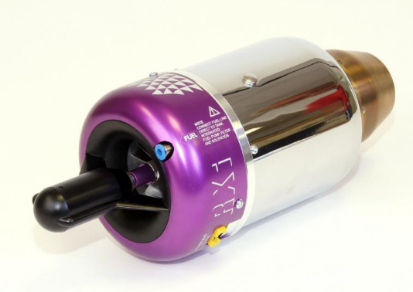
Problem
Instrument a department owned turbojet engine
JetCat RX Turbine

Slide 4
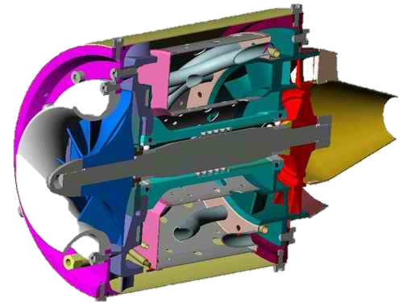
What Is a Turbojet Engine
Five main Components
Intake
Compressor
Combustion Chamber
Turbine
Nozzle
JetCat RX Turbine Cut Away

Slide 5
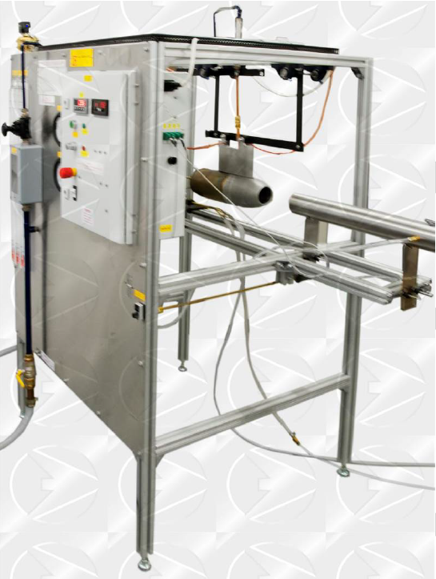
Proposed Solution
Design and build an instrumented test stand
Come within a 2% margin of error (sensor readings) at an affordable cost for apparatus instrumentation.

Slide 6
Impact
Competitive option for small jet engine manufactures
Research at UTRGV
Scholastic program

Slide 7
Market Shares
Total Market Size $10,250,000

Slide 8
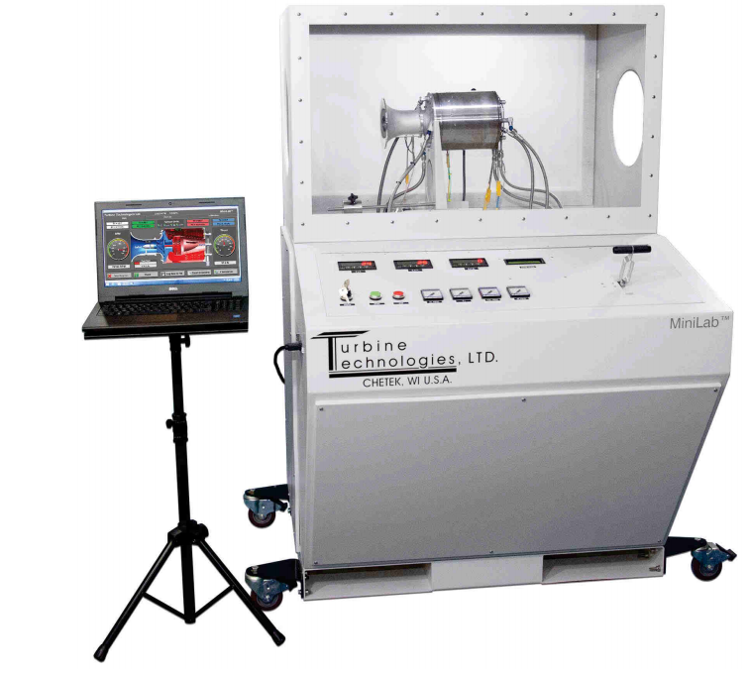
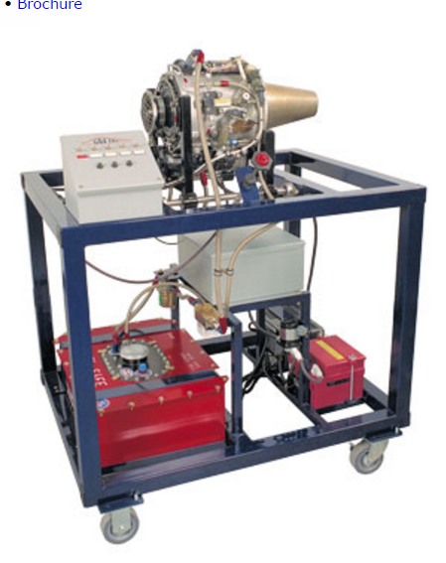
Company | Website | Address | Price | Information
P.A. Hilton | http://www.p-a-hilton.co.uk/teaching-equipment-for-sale.php?buy=327&addid=327 | P. A. Hilton Ltd Horsebridge Mill Kings Somborne Stockbridge Hampshire UK SO20 6PX | P372_V3- $ 72,500 | Offers test stands with integrated pulse and ramjets. These test stands are specifically aimed for education purposes and come with multiple sensors already installed.
Turbine Technologies | http://www.turbinetechnologies.com/ | Turbine Technologies, Ltd. 410 Phillips Court P.O. Box 105 Chetek, WI 54728 USA | MiniLab – $60,495.00 TurboGen - $121,095.00 | Includes National Instruments Data Acquisition system LabView. Provides custom virtual instrument panel with SR30 gas turbine engine.
GDJ Inc. | http://www.gdjinc.com/engine/engineintro.html | 7585 Tyler Boulevard Mentor, Ohio 44060 | PT-400 Base Price: $68,500.00 | This manufacturer makes fully integrated test stands for reciprocating and gas turbine engines. These stands already come with the engine integrally installed

Slide 9
Needs Wants and Constraints
Needs | Wants | Constraints
Accurate | Affordability | Cost
Damping of Vibration | Modularity | Safety
Durable | Aesthetically Appealing | Precision
User Friendly |  | Measurement Parameters

Slide 10
Goal: Develop an instrumented gas turbine test stand that will allow students to understand the limits and capabilities of a turbojet engine. Objective: Provide a precision test stand at low cost for scholastic and research usage.

Slide 11
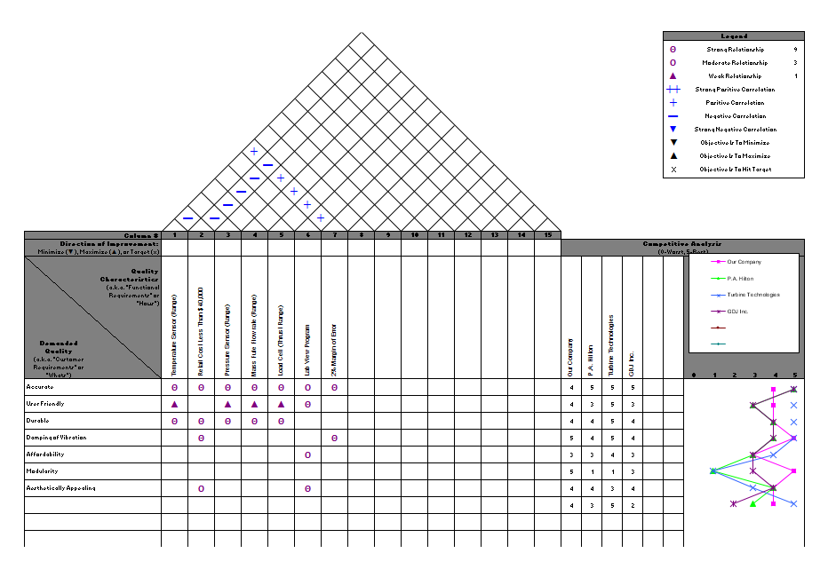
Quality Function Deployment
-
-
-
-
-
-
-
Technical Evaluation
Our Company | 800 | YES | 100 psi | 8.33 | 50 | YES | YES
P.A. Hilton | 700 | NO | 40 psi | 11.94 | 3.9 | NO | YES
Turbine Technologies | 720 | NO | N/A | 48 | 40 | YES | YES
GDJ Inc. | 800 | NO | N/A | N/A | 50 | YES | YES

Slide 12
Needs and Wants
Needs
-
-
-
-
-
-
Wants
-

Slide 13
Comparative Company Evaluation

Slide 14
Technical
Evaluation
Technical Evaluation
Our Company | 800 | 30,000 | 100 psi | 8.33 | 50 | YES | YES
P.A. Hilton | 700 | 72,500 | 40 psi | 11.9 | 3.9 | NO | YES
Turbine Technologies | 720 | 60,495 | N/A | 48 | 40 | YES | YES
GDJ Inc. | 800 | 68,500 | N/A | N/A | 50 | YES | YES

Slide 15
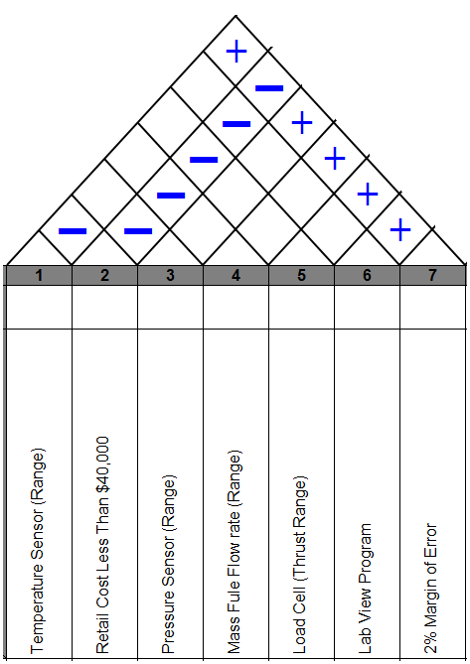
Engineering
Specifications

Slide 16
DESIGN EMBODIMENT

Slide 17
Concept Selection
Functional Decomposition
Engine Mount
Instrumentation
Structure
Methodology
Literature Search
Competitive Products
Brain Storming

Slide 18
Concept Selection for Engine Mount
Concept Variants
Rail
Linkage
Force Plate
Design Constraints
Cost
Accuracy
Reliability
Damping

Slide 19
Design Constraints
Sub-Function 1 -Engine Mount/Thrust Measurement
 | Cost | Accuracy | Reliability | Damping | Row Sum | Norm Score
Cost | x | 1 | 2 | 3 | 6 | 0.167
Accuracy | 5 | x | 3 | 4 | 12 | 0.333
Reliability | 4 | 3 | x | 4 | 11 | 0.306
Damping | 3 | 2 | 2 | x | 7 | 0.194
Col. Score | 12 | 6 | 7 | 11 | 36 | 1
12/36 =

Slide 20
Concept Variants
Cost
 | Rail | Linkage | Force plate | Row Sum | Norm Score
Rail | x | 3 | 5 | 8 | 0.444
Linkage | 3 | x | 5 | 8 | 0.444
Force plate | 1 | 1 | x | 2 | 0.111
Col. Score | 4 | 4 | 10 | 18 | 1
Accuracy
 | Rail | Linkage | Force plate | Row Sum | Norm Score
Rail | x | 4 | 3 | 7 | 0.389
Linkage | 2 | x | 2 | 4 | 0.222
Force plate | 3 | 4 | x | 7 | 0.389
Col. Score | 5 | 8 | 5 | 18 | 1
Reliability
 | Rail | Linkage | Force plate | Row Sum | Norm Score
Rail | x | 4 | 2 | 6 | 0.333
Linkage | 2 | x | 2 | 4 | 0.222
Force plate | 4 | 4 | x | 8 | 0.444
Col. Score | 6 | 8 | 4 | 18 | 1
Damping
 | Rail | Linkage | Force plate | Row Sum | Norm Score
Rail | x | 4 | 4 | 8 | 0.444
Linkage | 2 | x | 3 | 5 | 0.278
Force plate | 2 | 3 | x | 5 | 0.278
Col. Score | 4 | 7 | 7 | 18 | 1

Slide 21
Concept Comparison
Rail System
Linkage System
Force Plate System
24in
10in
13in
48in
18in
24in
Advantage | Disadvantage
Vibration Isolation | Alignment Issues
Low Cost
Compact
Advantage | Disadvantage
Simple to Manufacture | Alignment Issues Vibration
Low Cost
Advantage | Disadvantage
Static Mounting | Safety Hazard High Cost
Reliable

Slide 22
Chosen Thrust Measurement – Rail System
10in
4.5in
13in
18in
24in
24in

Slide 23
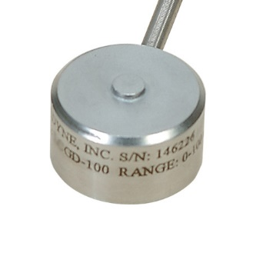
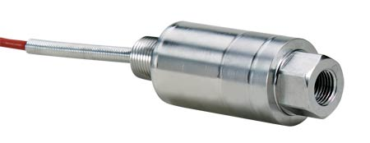
Functional Decomposition
Engine Mount
Instrumentation
Structure

Slide 24
Pitot Traversing Mechanism
Final Design
Engine and Engine Mount
60 in
60 in
24 in

Slide 25
Engine Mount
10in
13in
18in
24in

Slide 26
Force Transfer Rods
Mounting Plate
Engine Mount
Load Cell
Rail System
Isolated Plate
Sorbothane

Slide 27
Pitot Traversing Mechanism
24in
26in

Slide 28
Linear Bearing
Pitot Tube Mount
Guide Rail
Linear Bearing
Threaded Bearing
Guide Rail
Threaded Rod
Rack and Pinon
Rack and Pinon Crank
Threaded Rod Crank

Slide 29
Engineering Analysis
Vibration
Deflection
Total System Precision
Static

Slide 30
Deformation of Frame
Load = 40lbs
Element : Beams
Boundary Condition : Fixed Feet
Nodes : 612
Material : Steel
Max Displacement = 0.005 [in]
40lbs
SolidWorks – Static Analysis

Slide 31
Peak Stress of Frame
Load = 40lbs
Element : Beams
Boundary Condition : Fixed Feet
Nodes : 612
Material : Steel
Peak Stress = $2.8 [ksi]$
Load = 40lbs
Element : Beams
Boundary Condition : Fixed Feet
Nodes : 4484
Material : Steel
Peak Stress = $2.8 [ksi]$

Slide 32
Deflection of Pitot Traversing Rod
$$δ_{max}= \frac{{PL}^{3}}{48EI} [in]$$
P
$$δ_{max} :Max displacement [in]$$
$$d=0.5 [in]$$
E $:Modulus of steel [psi]$
$$I :Moment of inertia [{in}^{4}]$$
$E=30 x {10}^{6} [psi]$
$$L :Length [in]$$
$$I= \frac{πd^{4}}{64}{[in}^{4}]$$
$$P :Force [lbs]$$
$$P=5 [lb]$$
$$δ_{max}=0.02 [in]$$

Slide 33
Deflection of Pitot Tube
$$δ_{max}= \frac{{PL}^{3}}{3EI} [in]$$
$$δ_{max} :Max displacement [in]$$
E $:Modulus of stainles steel [psi]$
$$E=27.5 x {10}^{6} [psi]$$
$$I :Moment of inertia [{in}^{4}]$$
$$L=18 in.$$
$$L :Length [in]$$
$$I= \frac{π}{64} \left(d_{o}^{4}−d_{i}^{4}\right){ [in}^{4}]$$
$$d_{i}=0.13 in.$$
$$P :Force [lbs]$$
$$d_{o}=0.31 in.$$
$δ_{max}$ = 0.06 [in]
P = 6.37 lbs

Slide 34
Force Required to Slide Stand
$\sum{F_{y}=0}$
$\sum{F_{x}=0}$
$where W=N=280 \left[lbs\right]$
$μ=0.6$
$F− μN=0$
$F=168 [lbs]$
$168 lbs >40lbs$
N
$$F :Force [lbs]$$
$$N:Normal Force [lbs]$$
F
$$W:Weight [lbs]$$
$$μ: Coefficient of Static Friction$$
$$between Rubber and Concrete$$
W
μN

Slide 35
Fatigue Analysis
$$σ_{Bending}= \frac{32M}{πd^{3}} =3.66 [ksi]$$
$S_{n}^{′}= .5S_{u}$
$S_{u}$: Ultimate Tensile Strength
$C_{L}$: Load Factor
$C_{G}$: Gradient Factor
$C_{S}$ : Surface Factor
$C_{T}$: Temperature Factor $C_{R }:Reliability Factor$
$σ_{Bending}$: Bending Stress
F.S. = Factor of Safety
Endurance Limit :
$$S_{n}= S_{n}^{′}C_{L}C_{G}C_{S}C_{T}C_{R}$$
$$S_{n}=\left(0.5X61ksi\right)\left(1\right)\left(1\right)\left(0.79\right)\left(1\right)\left(0.897\right)=21.3 [ksi]$$
$$F.S. = \frac{S_{n}}{σ_{Bending}}$$
$F.S. = 5.8$
$$d=0.5 [in]$$
F = 10 [lbs]
$$L =4.5 [in]$$
Notes:
1020 cold drawn steel, 90% reliability

Slide 36
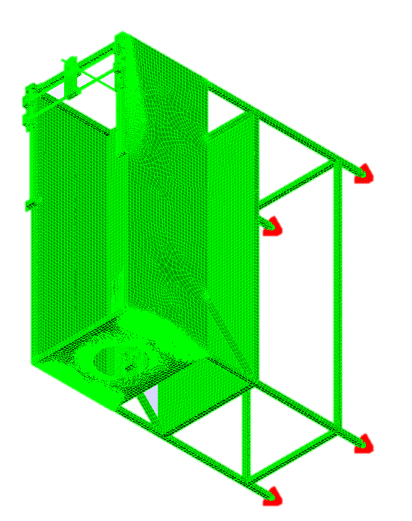
Mode Shape Analysis
Turbojet operating range : 533-2083 [Hz]
Identify structural resonance frequencies
Finite Element Method to be used to find mode shapes
Convergence of solution must be shown

Slide 37
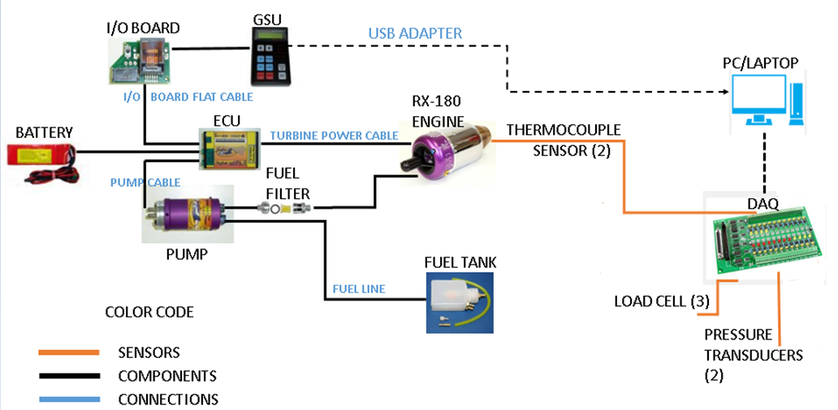
Wire Diagram for All Sensors of Engine

Slide 38
Zero-Order Uncertainty Analysis
Design-stage uncertainty
$u_{d}$=$\sqrt{μ_{0}^{2}+μ_{c}^{2}}$
Interpolation error
$u_{0}$
Instrument errors
$u_{c}$

Slide 39
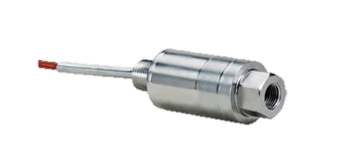
Zero-order Uncertainty Analysis for the Pressure Transducer
1: Pressure Transducer
a: Resolution: $u_{o}$= Interpolation Error= $\frac{u_{o}}{2}$
DAQ Resolution: $u_{o}$
12-bit DAQ
$u_{o}$= $\frac{E_{FSR}}{2^{m}}$=$\frac{10V}{2^{12}}$=0.0024V
→0.0024 Psi/30=0.01%
$u_{o}$=0.01%
b: Elemental Errors
e₁= linearity, hysteresis, repeatability=0.25%
e₂= zero balance=2.0%
Net Elemental Instrument Error = $u_{c}$= $\sqrt{e_{1}^{2}+e_{2}^{2}}$= $\sqrt{{0.25}^{2}+2^{2}}$
c: Zero-Order Uncertainty (Design-stage Uncertainty)
$u_{d}$=$\sqrt{u_{1}^{2}+u_{2}^{2}}$=$\sqrt{{(0.01)}^{2}+{(2.05)}^{2}}$=2.05>2%
OMEGA PX35D0 General Purpose
Pressure Transducer
Specifications
Excitation: 10 Vdc (15 V max)
Output: 3mV/V
Accuracy: 0.25% linearity, hysteresis and repeatability combined
$\frac{3mV}{V}$ x 10V = 30mV
0-30 psi : pressure range
0-30 mV
30 psi – 30 mV

Slide 40
Design For Safety
Design For Manufacturability
Two Emergency Stops
Plexi-glass partially enclosed housing
Safety manual
Consistent material thickness
Integer dimensions
Easy to find materials

Slide 41
Failure Modes & Effects Analysis (FMEA)

Slide 42
Rankings of Failure Modes
Part Details | Failure Mode | Severity | Frequency | Detectability | Risk Priority Number
Fuel System | Fuel Fire | 10 | 2 | 9 | 180
Turbojet | Turbine Malfunction (R.U.D)* | 10 | 2 | 10 | 200
Electrical System | Electrical Shorting | 9 | 2 | 9 | 162
Engine Mount | Mounts Failing | 9 | 2 | 8 | 144
Software | Software Malfunction | 5 | 3 | 6 | 90
Instrumentation | Calibration | 2 | 6 | 6 | 72
* Rapid Unexpected Disassembly

Slide 43
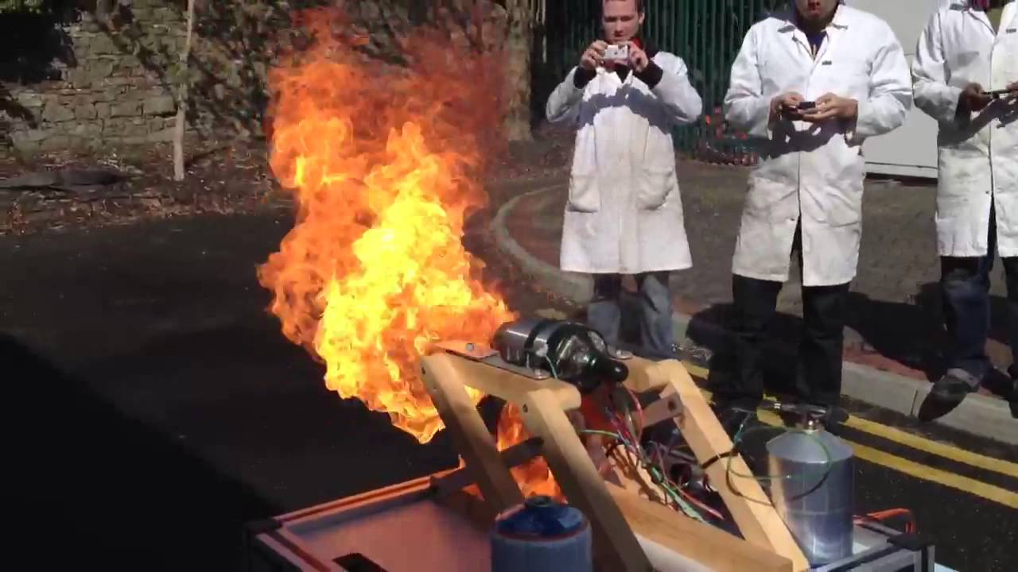
Rankings of Failure Modes Action 1
Part Details | Failure Mode | Severity | Frequency | Detectability | Risk Priority Number | Proposed Action | Reduction in RPN
Fuel System | Fuel Fire | 10 | 1 | 9 | 90 | Regular Inspections | 90
Turbojet | Turbine Malfunction (R.U.D) | 10 | 1 | 10 | 100 | Regular Maintenance | 100
Electrical System | Electrical Shorting | 9 | 1 | 9 | 81 | Regular Inspections | 81
Engine Mount | Mounts Failing | 9 | 1 | 8 | 72 |  | 72
Software | Software Malfunction | 5 | 1 | 8 | 40 | Performance Test | 50
Instrumentation | Calibration | 2 | 3 | 6 | 60 | Annual Calibration | 12

Slide 44
Economic Analysis
Bill of Materials
Prototype Cost
Production Cost
Retail Price

Slide 45
Bill of Materials
Material | Quantity | Provider | Cost $
Load Cell | 3 | Omega | 963
Pressure Transducer | 2 | Omega | 734
1in X 1in X 24ft 14 gage Square Steel Tubing | 4 | Alamo Iron Works | 130
Sorbothane | 1 | McMaster | 15.28
Pitot Probe | 1 | Zoro | 61.60
Set of Four Wheels | 1 | Rockler | 59.99

Slide 46
Production Cost
 | Unit | Year (100 units)
Labor Cost : 4 Production Employees 1 Engineer 1 Manager | $4,930 | $500,000
Material Cost | $2,500 | $520,000
Production Cost | $7,500 (Rounded)
Distributor Price (100% Profit) | $15,000 | $1,560,000
Retail Cost (100% Profit) | $30,000
*Competitive Retail Cost : $68,500 – 121,000

Slide 47
Summary
Market Analysis
Design Selection
Engineering Analysis
Economic Analysis

Slide 48
References
By Continuing to Browse the Site You Are Agreeing to Our Use of Cookies. Find out More Here. "PA Hilton Engineering Teaching Equipment. Technical Training Equipment. Vocational Equipment." PA Hilton Engineering Teaching Equipment. Technical Training Equipment. Vocational Equipment. N.p., n.d. Web. 22 Sept. 2016. <http://www.p-a-hilton.co.uk/>.
"Emprise Corporation." ZoomInfo. N.p., n.d. Web. 29 Sept. 2016. <http://www.zoominfo.com/c/Emprise-Corporation/17303129>.
"GDJ Inc." ZoomInfo. N.p., n.d. Web. 22 Sept. 2016. <http://www.zoominfo.com/c/GDJ-Inc/15712337>.
Group, JPS Design. "Welcome." GDJ, Inc. N.p., n.d. Web. 22 Sept. 2016. <http://www.gdjinc.com/>.
"Integrated Flow Systems Llc." ZoomInfo. N.p., n.d. Web. 29 Sept. 2016. <http://www.zoominfo.com/c/Integrated-Flow-Systems-Llc/343510787>.
N.p., n.d. Web. <http://www.p-a-hilton.co.uk/teaching-equipment-for-sale.php?buy=327&addid=327>.
"P A Hilton." ZoomInfo. N.p., n.d. Web. 22 Sept. 2016. <http://www.zoominfo.com/c/P-A-Hilton/348843272>.
P.A. Hilton. N.d. Jet Propulsion Test Stand P372 Specs. England, Hampsire Stockridge.
Turbine Technologies. 2014. Turbo gen. Chetek, Wisconsin.
Turbine Technologies- Creating Educational Lab Equipment For Tomorrow's Engineers. "Controls Lab ." Turbine Technologies. N.p., n.d. Web. 22 Sept. 2016. <http://www.turbinetechnologies.com/>.
Turbine Technologies Inc. 2014. MiniLab Specs. Chetek, Wisconsin.
"Turbine Technologies Inc." ZoomInfo. N.p., n.d. Web. 22 Sept. 2016. <http://www.zoominfo.com/c/Turbine-Technologies-Inc/348276565>

Slide 49
Thank You
We would like to thank the following faculty…
Dr. Sarkar
Dr. Choutapalli
Dr. Jones
Dr. Fuentes
Dr. Tarawneh
Dr. Lee
Dr. Crown
Dr. Park
Mr. Potter

Slide 52
Force Required to Tip
F
$$\sum{M_{A}=0}$$
$$F=75lbs$$
12 in
60 in
W
A

Slide 55
Bill of Materials

Slide 56
Vibrational Analysis
$$X= \frac{m_{0}e}{m}\frac{r^{2}}{\sqrt{{(1−r^{2})}^{2}+{(2ζr)}^{2}}}$$
Where $F_{0}= m_{0}eω_{r}^{2}$
$$X= \frac{F_{0}}{ω_{r}^{2}m}\frac{r^{2}}{\sqrt{{(1−r^{2})}^{2}+{(2ζr)}^{2}}}$$
F
$$X=$$

Slide 57
Rankings of Failure Modes Action 2
Part Details | Failure Mode | Severity | Frequency | Detectability | Risk Priority Number | Proposed Action | Reduction in RPN
Frame | Rigidity | 7 | 1 | 3 | 21 | Brace | 3
Turbine | Efficiency | 5 | 2 | 9 | 90 | Maintenance | 18
Transducer | Calibration | 9 | 3 | 2 | 54 | Replace | 0
Thermocouples | Calibration | 6 | 3 | 2 | 36 | Replace | 0
Mass Flow Sensor | Calibration | 8 | 3 | 2 | 48 | Replace | 0
Load Cell | Calibration | 9 | 3 | 2 | 54 | Replace | 0
Pitot Tube | Deflection | 8 | 1 | 1 | 8 | Replace | 4
Software | Computer Failure | 4 | 9 | 4 | 144 | Performance Testing | 36
Wheel Rack | Support Failure | 6 | 1 | 1 | 6 | Brace | 1

Slide 58
Sub–Function 2 - Instrumentation
 | Cost | Accuracy | Reliability | Row Sum | Nom Score
Cost | x | 1 | 1 | 2 | 0.111
Accuracy | 5 | x | 3 | 8 | 0.444
Reliability | 5 | 3 | x | 8 | 0.444
Col. Score | 9 | 4 | 5 | 18 | 1

Slide 59
Concept Variants
Cost
 | Pressure Transducer | Thermocouples | Fuel Flow Meter | Load Cell | Row Sum | Nom Score
Pressure Transducers | x | 5 | 4 | 3 | 12 | 0.333
Thermocouples | 1 | x | 1 | 1 | 3 | 0.083
Fuel Flow Meter | 2 | 5 | x | 2 | 9 | 0.250
Load Cell | 3 | 5 | 4 | x | 12 | 0.333
Col. Score | 6 | 15 | 9 | 6 | 36 | 1
Accuracy
 | Pressure Transducer | Thermocouples | Fuel Flow Meter | Load Cell | Row Sum | Nom Score
Pressure Transducers | x | 5 | 4 | 3 | 12 | 0.333
Thermocouples | 1 | x | 1 | 1 | 3 | 0.0833
Fuel Flow Meter | 2 | 5 | x | 2 | 9 | 0.25
Load Cell | 3 | 5 | 4 | x | 12 | 0.333
Col. Score | 6 | 15 | 9 | 6 | 36 | 1
Reliability
 | Pressure Transducer | Thermocouples | Fuel Flow Meter | Load Cell | Row Sum | Nom Score
Pressure Transducer | x | 5 | 4 | 3 | 12 | 0.333
Thermocouples | 1 | x | 1 | 1 | 3 | 0.083
Fuel Flow Meter | 2 | 5 | x | 2 | 9 | 0.250
Load Cell | 3 | 5 | 4 | x | 12 | 0.333
Col. Score | 6 | 15 | 9 | 6 | 36 | 1

Slide 60
Sub-Function 2 -Selection
Instrumentation
 | Cost | Accuracy | Reliability | Score
Pressure Transducer | 0.0369 | 0.148 | 0.148 | 0.3329
Thermocouple | 0.00921 | 0.0369 | 0.0369 | 0.08301
Fuel Flow | 0.0278 | 0.111 | 0.111 | 0.2498
Load Cell | 0.0369 | 0.148 | 0.148 | 0.3329
Decision |  |  |  | P.T. and L.C

Slide 61
Sub-Function 3 - Structure
 | Cost | Aesthetics | Safety | Mobility | Row Sum | Nom Score
Cost | x | 3 | 1 | 4 | 8 | 0.222
Aesthetics | 3 | x | 1 | 2 | 6 | 0.167
Safety | 5 | 5 | x | 5 | 15 | 0.417
Mobility | 2 | 4 | 1 | x | 7 | 0.194
Col. Score | 10 | 12 | 3 | 11 | 36 | 1

Slide 62
Concept Variants
Cost
 | Unenclosed | Partially Enclosed | Full Environment Enclosure | Row Sum | Nom Score
Unenclosed | x | 4 | 5 | 9 | 0.5
Partially Enclosed | 2 | x | 5 | 7 | 0.388
Full Enviornment Enclosure | 1 | 1 | x | 2 | 0.111
Col. Score | 3 | 5 | 10 | 18 | 1
Aesthetics
 | Unenclosed | Partially Enclosed | Full Environment Enclosure | Row Sum | Nom Score
Unenclosed | x | 2 | 3 | 5 | 0.277
Partially Enclosed | 4 | x | 4 | 8 | 0.444
Full Enviornment Enclosure | 3 | 2 | x | 5 | 0.277
Col. Score | 7 | 4 | 7 | 18 | 1

Slide 63
Continued
Safety
 | Unenclosed | Partially Enclosed | Full Environment Enclosure | Row Sum | Nom Score
Unenclosed | x | 1 | 1 | 2 | 0.111
Partially Enclosed | 5 | x | 2 | 7 | 0.389
Full Enviornment Enclosure | 5 | 4 | x | 9 | 0.5
Col. Score | 10 | 5 | 3 | 18 | 1
Mobility
 | Unenclosed | Partially Enclosed | Full Enviornment Enclosure | Row Sum | Nom Score
Unenclosed | x | 3 | 5 | 8 | 0.444
Partially Enclosed | 3 | x | 5 | 8 | 0.444
Full Enviornment Enclosure | 1 | 1 | x | 2 | 0.111
Col. Score | 4 | 4 | 10 | 18 | 1

Slide 64
Sub-Function 3 -Selection
Structure
 | Cost | Aesthetics | Safety | Mobility | Score
Unenclosed | 0.111 | 0.0464 | 0.0759 | 0.0861 | 0.3194
Partial Enclosure | 0.0864 | 0.0741 | 0.265 | 0.0861 | 0.5116
Full Environment Enclosure | 0.0246 | 0.0464 | 0.0759 | 0.0215 | 0.1684
Decision |  |  |  |  | Partial Enclosure

Slide 65
Sub-Function 2 -Selection
Instrumentation
 | Cost | Accuracy | Reliability | Score
Pressure Transducer | 0.0369 | 0.148 | 0.148 | 0.3329
Thermocouple | 0.00921 | 0.0369 | 0.0369 | 0.08301
Fuel Flow | 0.0278 | 0.111 | 0.111 | 0.2498
Load Cell | 0.0369 | 0.148 | 0.148 | 0.3329
Decision |  |  |  | P.T. and L.C

Slide 66
Sub-Function 3 -Selection
Structure
 | Cost | Aesthetics | Safety | Mobility | Score
Unenclosed | 0.111 | 0.0464 | 0.0759 | 0.0861 | 0.3194
Partial Enclosure | 0.0864 | 0.0741 | 0.265 | 0.0861 | 0.5116
Full Environment Enclosure | 0.0246 | 0.0464 | 0.0759 | 0.0215 | 0.1684
Decision |  |  |  |  | Partial Enclosure

Slide 67
Proposed Solutions
Thrust Measurement – Force Plate

Slide 68
Sub-Function 1 –Final Selection
Engine Mount/Thrust
 | Cost | Accuracy | Reliability | Damping | Score
Rail | 0.074 | 0.129 | 0.102 | 0.086 | 0.392
Linkage | 0.074 | 0.074 | 0.068 | 0.054 | 0.270
Force plate | 0.019 | 0.129 | 0.136 | 0.054 | 0.338
Decision |  |  |  |  | Rail

Slide 69
Continued
Reliability
 | Rail | Linkage | Force plate | Row Sum | Norm Score
Rail | x | 4 | 2 | 6 | 0.333
Linkage | 2 | x | 2 | 4 | 0.222
Force plate | 4 | 4 | x | 8 | 0.444
Col. Score | 6 | 8 | 4 | 18 | 1
Damping
 | Rail | Linkage | Force plate | Row Sum | Norm Score
Rail | x | 4 | 4 | 8 | 0.444
Linkage | 2 | x | 3 | 5 | 0.278
Force plate | 2 | 3 | x | 5 | 0.278
Col. Score | 4 | 7 | 7 | 18 | 1

Slide 70
Software Methodology
Identify Test Environment
Determine Performance Criteria
Plan & Design
Configure Test Environment
Implement Test Design
Run Tests
Analyze, finetune % Re-test

